Slide 1
L E C T U R E
09
Project Scheduling and Tracking
Notes:
This repository of slides is intended to support the named chapter. The slide repository should be used as follows:
Copy the file to a unique name for your course and unit.
Edit the file by deleting those slides you don’t want to cover, editing other slides as appropriate to your course, and adding slides as desired.
Print the slides to produce transparency masters or print directly to film or present the slides using a computer image projector.
Each slide includes instructor notes. To view those notes in PowerPoint, click-left on the View Menu; then click left on Notes View sub-menu. You may need to scroll down to see the instructor notes.
The instructor notes are also available in hardcopy as the Instructor Guide to Accompany Systems Analysis and Design Methods, 5/ed.

Slide 2
Project Scheduling and Tracking
Software project managers
Proper scheduling requires that
(1) all tasks appear in the network,
(2) effort and timing are intelligently allocated to each task,
(3) interdependencies between tasks are properly indicated,
(4) resources are allocated for the work to be done, and
(5) Closely spaced milestones are provided so that progress can be tracked.
to create a network of software
engineering tasks that will enable you to get the
job done on time.
What is it?
Who does it?
Why is it important?
What are the steps?
What is the work product?
How do I ensure that I’ve done it right?
The software engineering
tasks dictated by the software process model are refined for the functionality to be built.
virtually impossible to assess
progress on a moderate or large software project without a detailed schedule.
The project schedule and
related information are produced.

Slide 3
Basic Concepts
Although there are many reasons why software is delivered late, most can be traced to one or more of the following root causes:
An unrealistic deadline established by someone outside the software development group and forced on managers and practitioner's within the group.
• Changing customer requirements that are not reflected in schedule changes.
• An honest underestimate of the amount of effort and/or the number of resources that will be required to do the job.
• Predictable and/or unpredictable risks that were not considered when the project commenced.

Slide 4
Technical difficulties that could not have been foreseen in advance.
• Human difficulties that could not have been foreseen in advance.
• Miscommunication among project staff that results in delays.
• A failure by project management to recognize that the project is falling behind schedule and a lack of action to correct the problem.

Slide 5
What should we do when management demand that we make a deadline that is impossible?
1.Perform a detailed estimate using historical data from past projects. Determine the estimated effort and duration for the project.
2. Using an incremental process model (lecture-3), develop a software engineering strategy that will deliver critical functionality by the imposed deadline, but delay other functionality until later. Document the plan.
3. Meet with the customer and (using the detailed estimate), explain why the imposed deadline is unrealistic. Be certain to note that all estimates are based on performance on past projects. Also be certain to indicate the percent improvement that would be required to achieve the deadline as it currently exists.

Slide 6
Software project scheduling is an activity that distributes estimated effort across the planned project duration by allocating the effort to specific software engineering tasks.

Slide 7
Like all other areas of software engineering, a number of basic principles guide software project scheduling:
Compartmentalization.
Interdependency.
Time allocation.
Effort validation.
Defined responsibilities.
Defined outcomes.
Defined milestones.

Slide 8
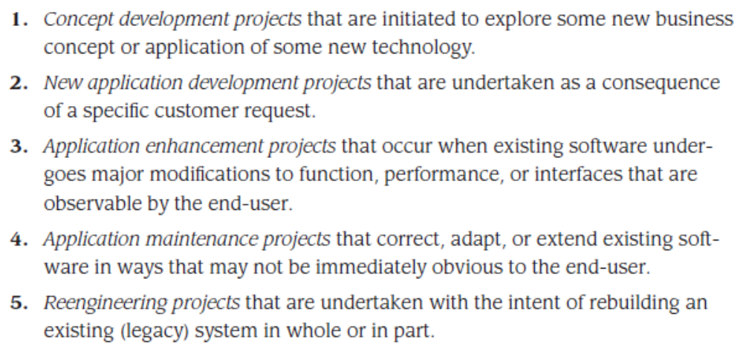
DEFINING A TASK SET FOR THE SOFTWARE PROJECT
A task set is a collection of software engineering work tasks, milestones, and deliverables that must be accomplished to complete a particular project.
Even within a single project type, many factors influence the task set to be chosen.

Slide 9
Degree of Rigor
Even for a project of a particular type, the degree of rigor with which the software
process is applied may vary significantly.
The degree of rigor is a function of many project characteristics.
As an example, small, non-business-critical projects can generally be addressed with somewhat less rigor than large, complex business-critical applications.
It should be noted, however, that all projects must be conducted in a manner that results in timely, high-quality deliverables.
Four different degrees of rigor can be defined:
Casual
Structured
Strict
Quick reaction

Slide 10
Defining Adaptation Criteria
Adaptation criteria are used to determine the recommended degree of rigor with which the software process should be applied on a project. Eleven adaptation criteria [PRE99] are defined for software projects:
• Size of the project
• Number of potential users
• Mission criticality
• Application longevity
• Stability of requirements
• Ease of customer/developer communication
• Maturity of applicable technology
• Performance constraints
• Embedded and nonembedded characteristics
• Project staff
• Reengineering factors

Slide 11
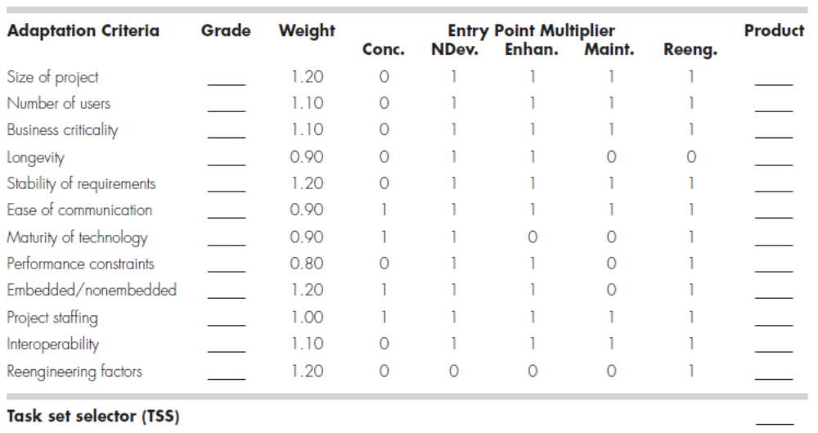
COMPUTING THE TASK SET SELECTOR

Slide 12
How do we choose the appropriate task for our project?
To select the appropriate task set for a project, the following steps should be conducted:
Review each of the adaptation criteria and assign the appropriate grades (1 to 5) based on the characteristics of the project. These grades should be entered into prescribe table.
Review the weighting factors assigned to each of the criteria. The value of a weighting factor ranges from 0.8 to 1.2 and provides an indication of the relative importance of a particular adaptation criterion to the types of software developed within the local environment. If modifications are required to better reflect local circumstances, they should be made.

Slide 13
3. Multiply the grade entered in Table by the weighting factor and by the entry point multiplier for the type of project to be undertaken. The entry point multiplier takes on a value of 0 or 1 and indicates the relevance of the adaptation criterion to the project type. The result of the product grade x weighting factor x entry point multiplier
is placed in the Product column of Table 7.1 for each adaptation criteria individually.
4. Compute the average of all entries in the Product column and place the result in the space marked task set selector (TSS). This value will be used to help select the task set that is most appropriate for the project.

Slide 14
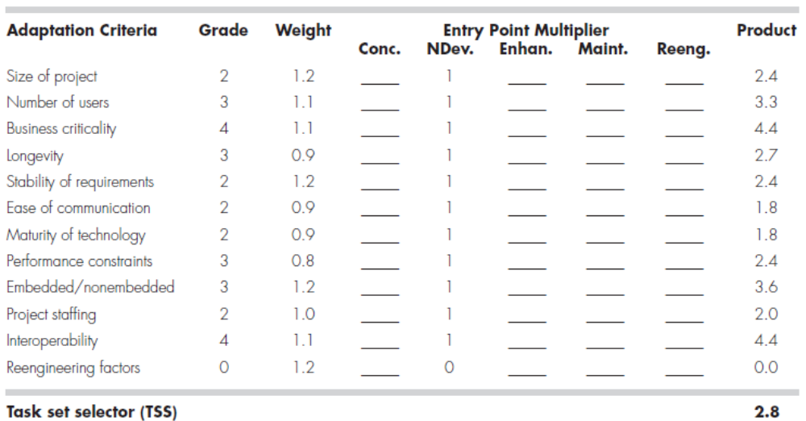
COMPUTING THE TASK SET SELECTOR—AN EXAMPLE

Slide 15
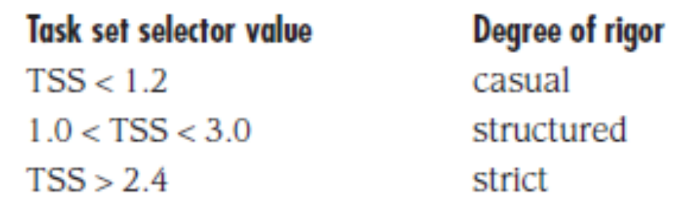
Interpreting the TSS Value and Selecting the Task Set
Once the task set selector is computed, the following guidelines can be used to select the appropriate task set for a project:

